Slide 1
Dimensionality Reduction Techniques for Improved Diagnosis of Heart Disease
Group 2 : Rachel, Teshani, Komalpreet, Shwetha

Slide 2
Introduction
Heart disease is a leading cause of mortality worldwide and requires early, accurate diagnosis.
Diagnostic data often include numerous clinical variables, making the analysis complex.
Dimensionality reduction and classification techniques help:
Extract meaningful patterns from high-dimensional data.
Improve prediction accuracy and model interpretability.

Slide 3
Objectives
Our study explores dimensionality reduction and classification methods on the Cleveland Heart Disease Dataset to optimize prediction models.
Methods like PCA, MCA, FA and LDA reduce redundancy, enhance interpretability, and provide insights into heart disease diagnosis.

Slide 4
Overview
We aim to achieve our objectives by :
Understanding variance using principal components.
Identifying latent factors.
Representing and analyzing categorical data via Multiple Correspondence Analysis (MCA).
Evaluating classification efficacy with Linear Discriminant Analysis (LDA).
Optimizing predictions using stepwise regression.

Slide 5
Dataset Overview
Population: 303 individuals with heart disease-related symptoms from the Cleveland Heart Disease Database.
Quantitative Variables -
Variable Name | Description | Unit
Age | The patient’s age | years
Resting Blood Pressure | patient's level of blood pressure at resting mode | mm/HG
Cholesterol (chol) | The serum cholesterol level | mg/dl
Maximum Heart Rate | measures the highest heart rate reached during physical exertion
Oldpeak | Exercise induced ST-depression in relative with the state of rest

Slide 6
Qualitative Variables
Variable Name | Description
Chest Pain Type (cp) | Type of chest pain experienced by patient
Resting Electrocardiographic Results (restecg) | Measures heart function during rest
Exercise-Induced Angina (exang) | Measures whether physical exertion induces chest pain
Major Vessels (ca) | Counts the number of major vessels (0–3)
Thalassemia (thal) | A blood disorder measured

Slide 7
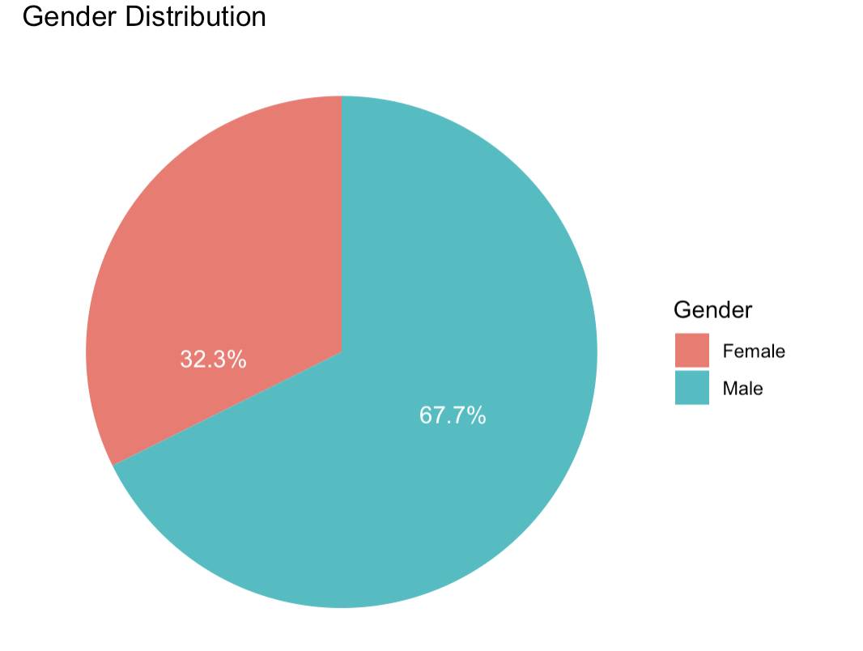
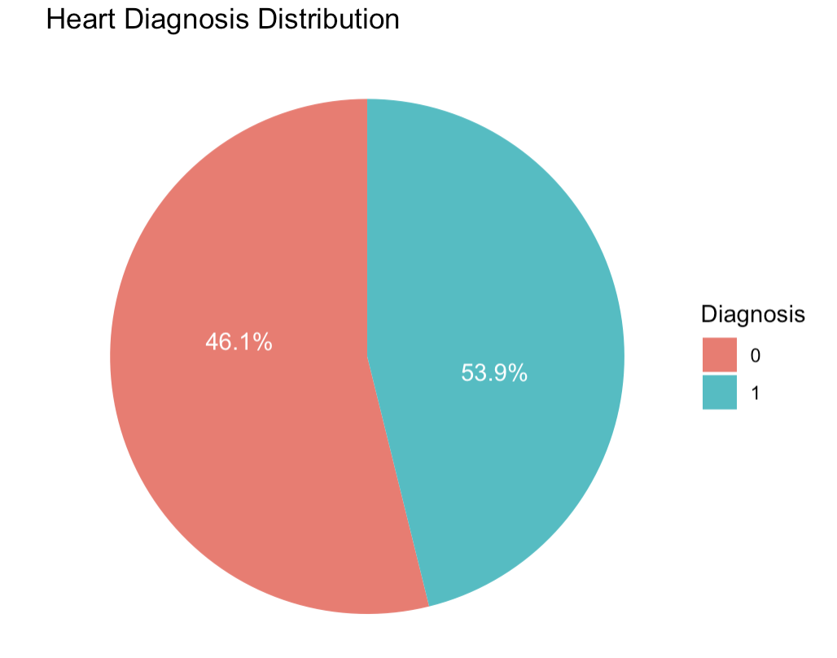
Possible bias
Data Imbalance - Models might favor the majority class.
Measurement Bias - Diagnostic tools, criteria, or procedures used to collect the dataset may introduce bias.

Slide 8
Literature Review
Dimensionality Reduction Techniques for Heart Disease Diagnosis

Slide 9
Literature Review
Overview:
Heart disease is a leading cause of mortality worldwide.
Accurate and efficient diagnosis is crucial for effective treatment.
Medical datasets are often high-dimensional and complex, necessitating dimensionality reduction techniques.
Importance of Dimensionality Reduction:
Reduces computational complexity.
Enhances the performance of machine learning models.
Helps in identifying the most relevant features for diagnosis

Slide 10
Principal Component Analysis (PCA)
Methodology:
PCA transforms the original features into a new set of uncorrelated components.
Application to Heart Disease Data:
PCA was applied to the Cleveland heart dataset, reducing the number of features while retaining essential information.
The first three principal components were found to be significant, explaining a substantial portion of the variance.
Results:
PCA-based models showed improved accuracy and reduced computational time compared to models using all original features.

Slide 11
Factor Analysis (FA)
Factor Analysis:
FA identifies common factors that influence multiple observed variables.
Reduces the dataset to a smaller number of factors, capturing the shared variance.
Application to Heart Disease Data:
FA was used to extract three common factors from the Cleveland heart dataset.
These factors were used as inputs to neural network classifiers.
Conclusion:
Dimensionality reduction techniques like PCA and FA significantly enhance the diagnostic performance of machine learning models.

Slide 12
Reference
Shilaskar, S., & Ghatol, A. (2013). Dimensionality Reduction Techniques for Improved Diagnosis of Heart Disease. International Journal of Computer Applications, 61(5).
Perumal, R., & Kaladevi, A. C. (2020). Early Prediction of Coronary Heart Disease from Cleveland Dataset using Machine Learning Techniques.

Slide 13
Data Cleaning
There were 303 rows of data in Cleveland Heart Data set.
6 rows had missing values for Thalessemia
These rows were omitted, giving 297 complete data rows.
The target variable (Diagnosis of Heart Disease) had values 0, 1,2,3,4
Since any value above 0 indicates the presence of heart disease, we coded them to be 1.
Converted the qualitative variables into factors and the quantitative variables to numerical.

Slide 14
Insights from Exploratory Analysis

Slide 15
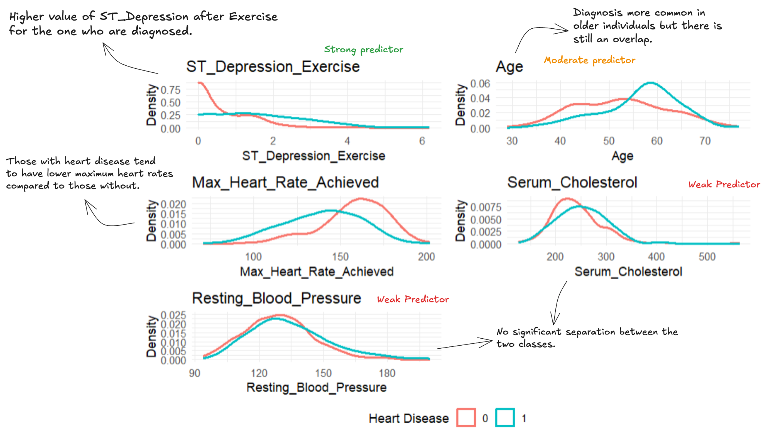
Distribution of Numerical Features

Slide 16
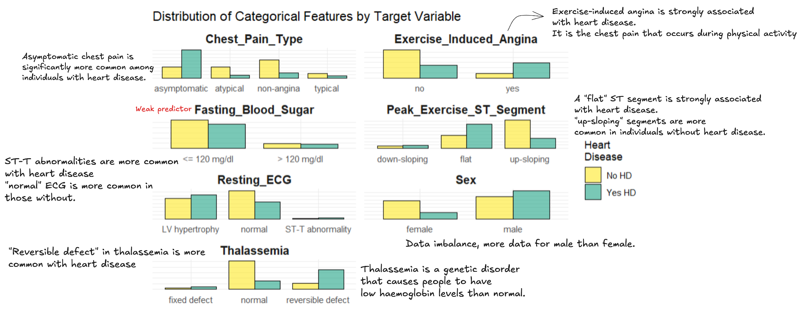
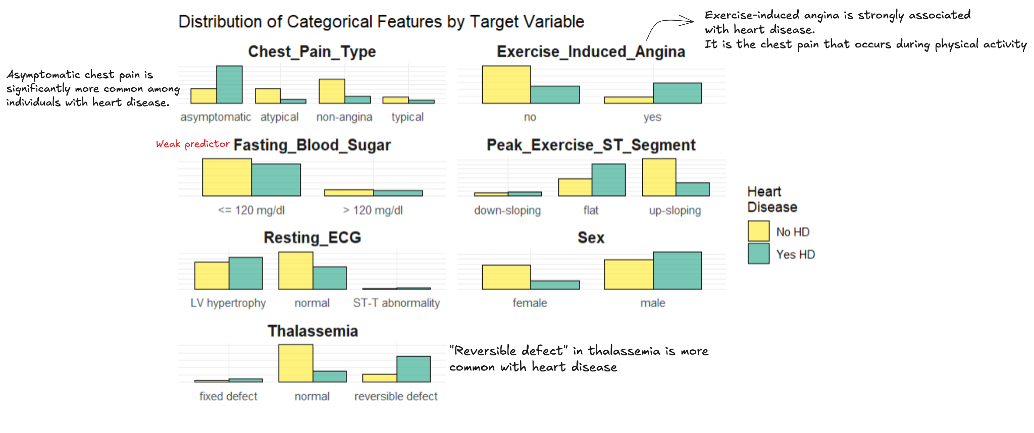

Slide 17
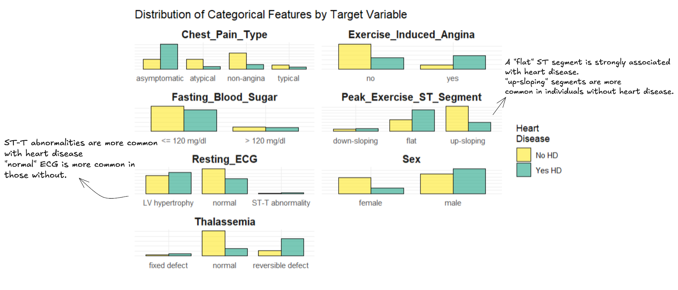

Slide 18
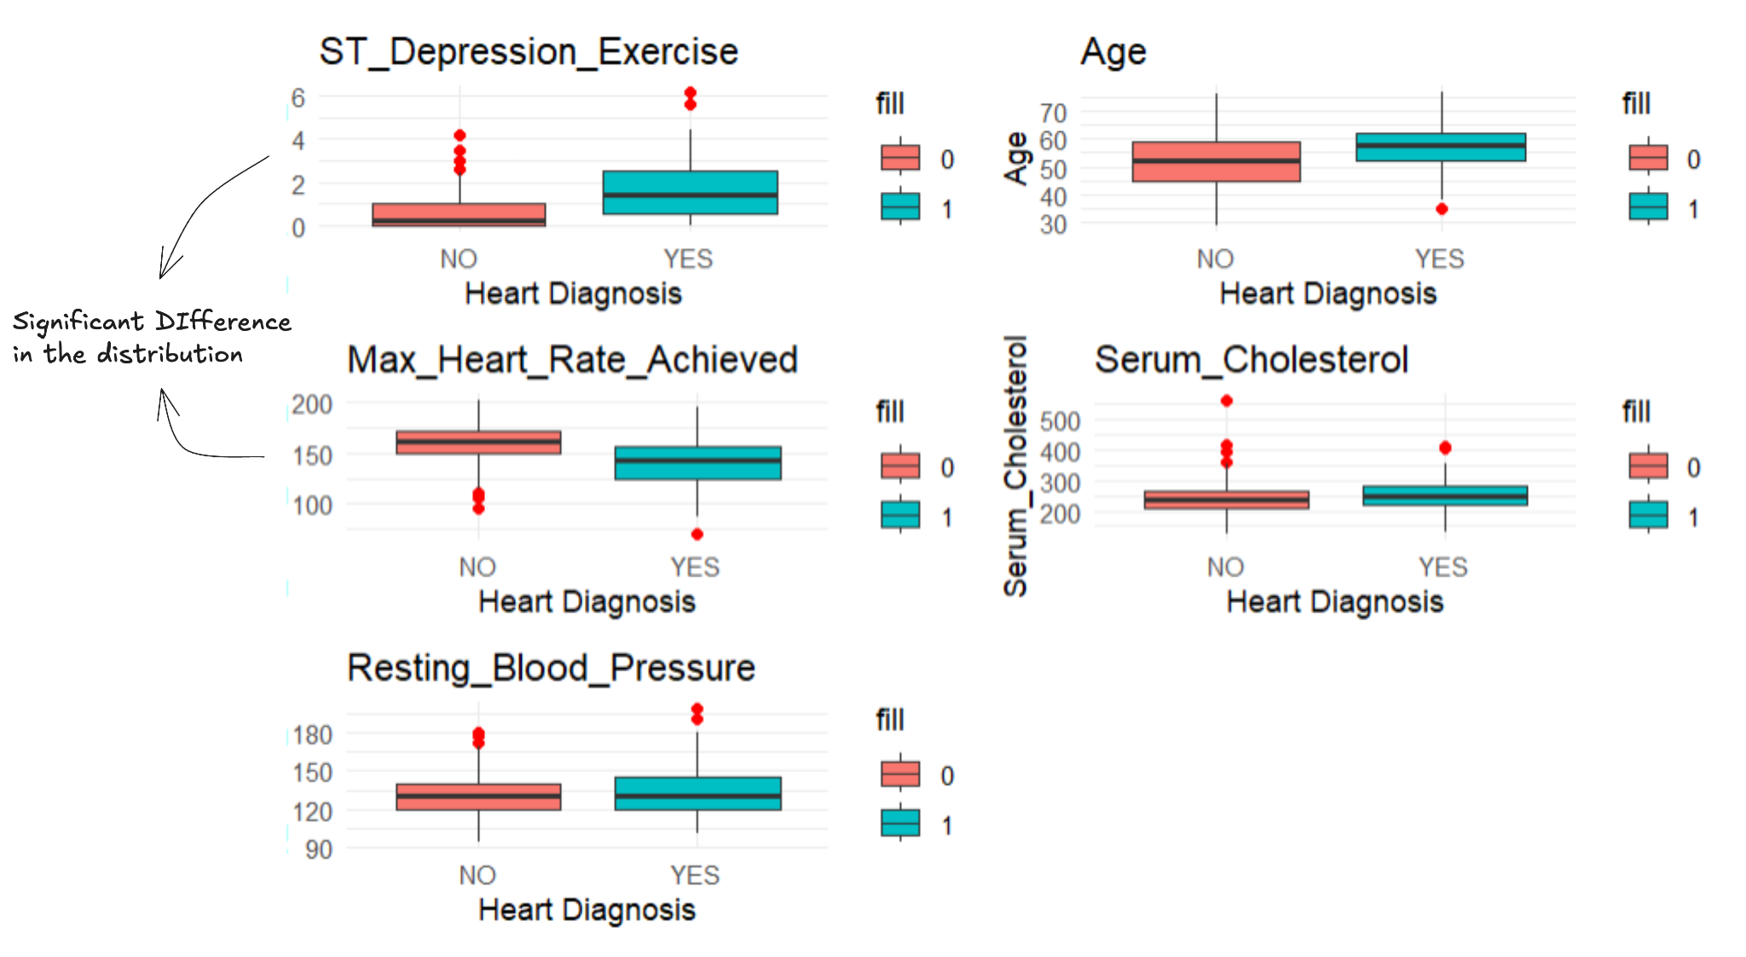
Box Plots of Numerical Variable

Slide 19
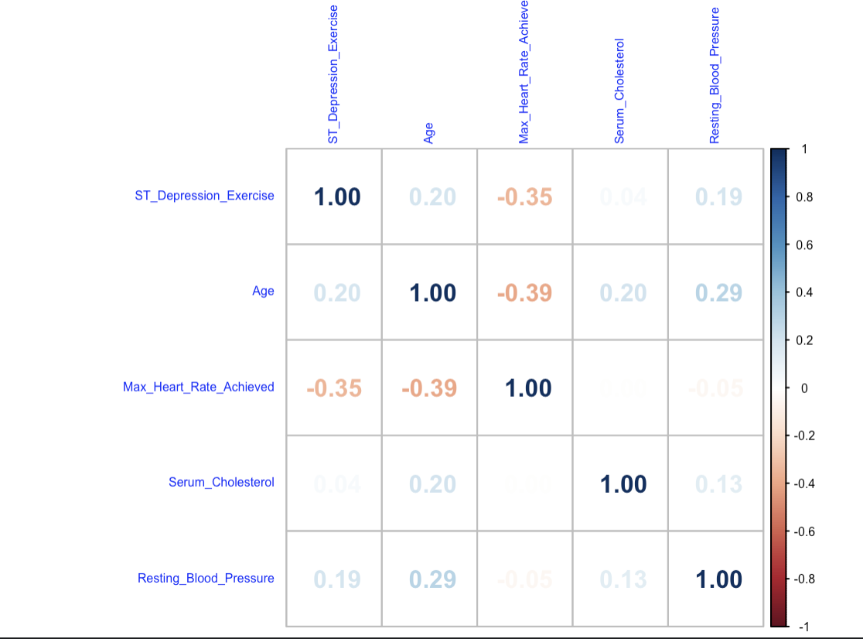
Do we need Principal Component Analysis?
Most of the numerical variables are weakly correlated, with correlations ranging between 0 and 0.39.
PCA isn't just for highly correlated features—it can help:
Reduce dimensionality.
Simplify feature space for better visualization and analysis.

Slide 20
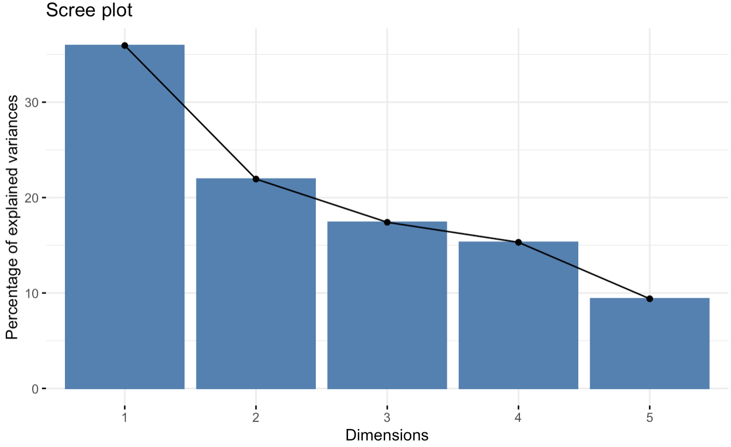
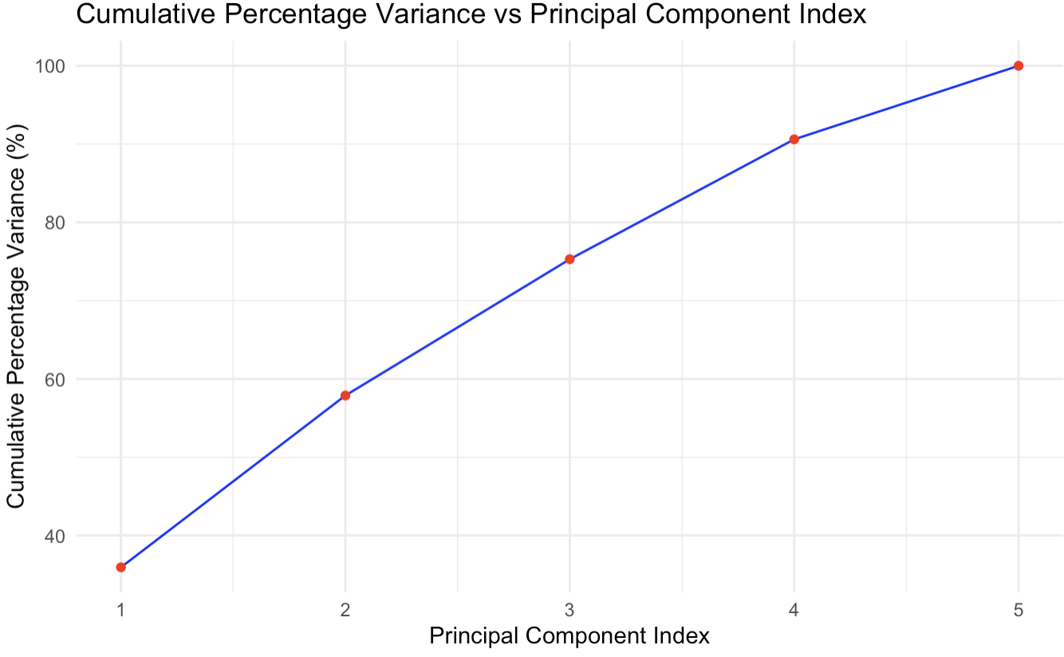
How many Principal Components?
Scree Plot suggests 2
80-90% total variance method suggests 4 Principal Components

Slide 21
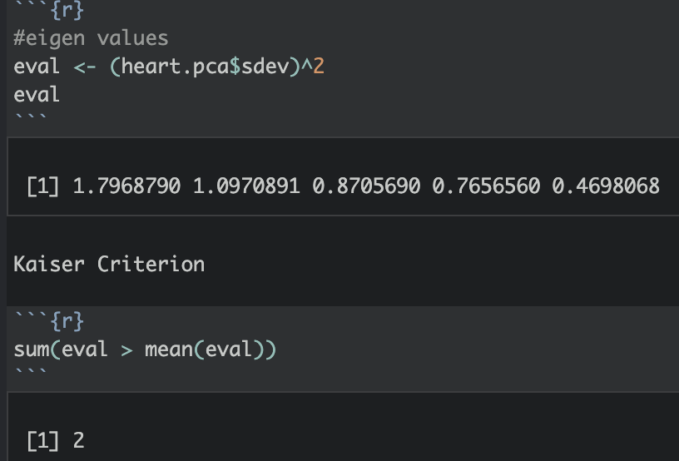
How many Principal Components?
Kaiser Criterion suggests 2.
We can use 2 Components when interpretability, speed, and simplicity are priorities (e.g., visualizations or quick insights).
Use 4 Components (90% variance) for robust and detailed predictive modeling to ensure the model has access to all meaningful information from the data.

Slide 22
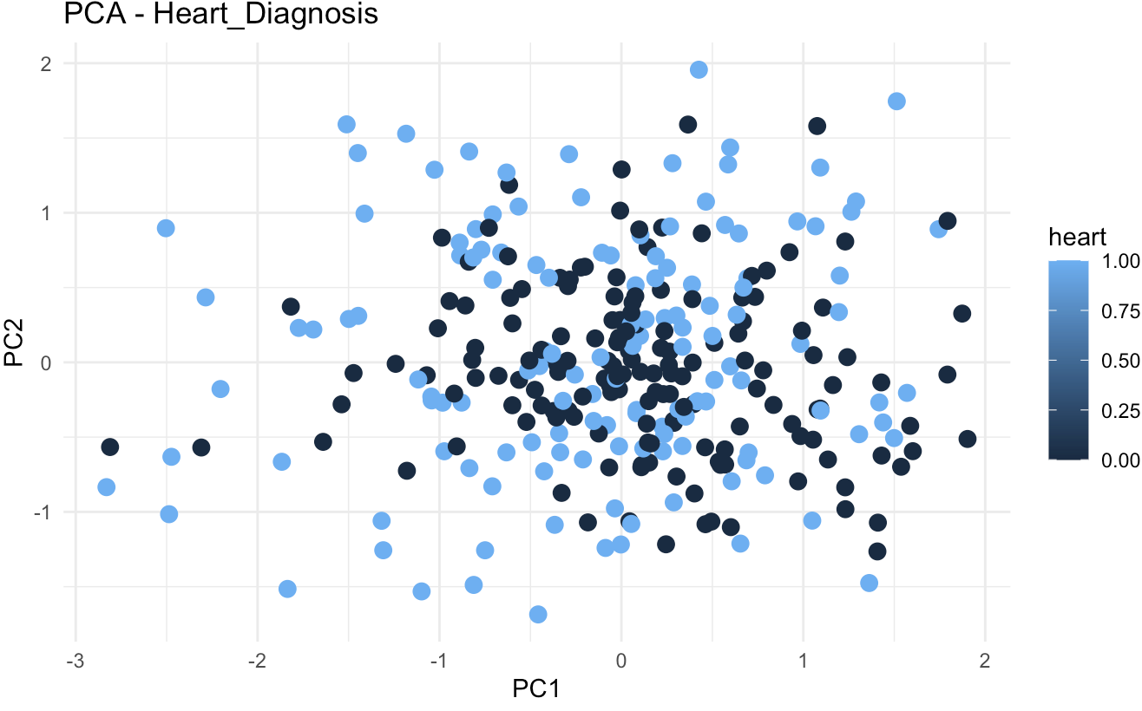
Visualization in Principal Component Space
There is significant overlap between the two classes (heart disease and no heart disease), indicating that PC1 and PC2 alone do not fully separate the two groups.
However, there may still be subtle trends or patterns, as the light blue points appear slightly more spread in certain regions.

Slide 23
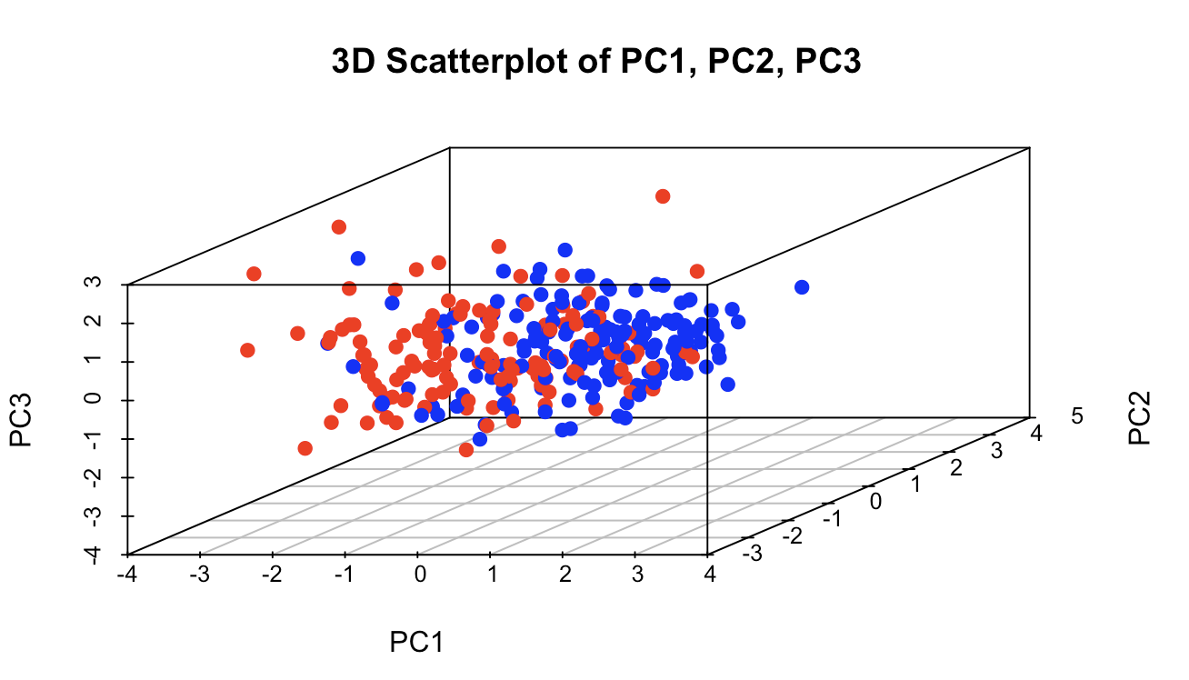
Visualization in Principal Component Space
The scatterplot reveals clusters that may correspond to patients with and without heart disease (e.g., blue vs. red points).
While PC1 provides the primary separation, adding PC2 and PC3 enhances the distinction between these groups.
PC1 captures the majority of variance, spreading data widely along its axis.
PC2 and PC3 add depth to the analysis by separating data points that are not distinguishable on PC1 alone.

Slide 24
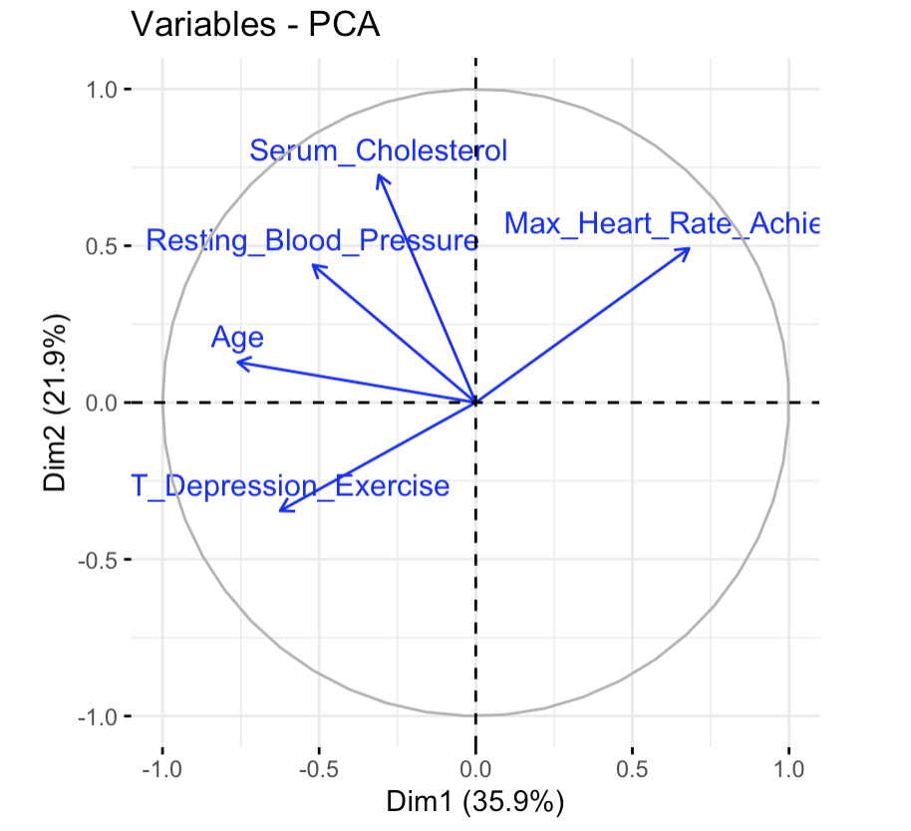
Understanding Variable Contributions in PCA
Variables like Serum Cholesterol and Maximum Heart Rate Achieved are strongly correlated with PC1 (longer arrows pointing in similar directions).
ST Depression Exercise (Oldpeak) and Age are more associated with PC2, as their arrows align closer to that axis.
Variables with shorter arrows, like Resting Blood Pressure, contribute less to the variance explained by PC1 and PC2.

Slide 25
Insights from the Biplot
PC1 seems to capture a combination of clinical metrics such as cholesterol and heart rate, likely representing overall cardiovascular health.
PC2 may reflect age and exercise-induced factors, indicating a different underlying pattern in the data.

Slide 26
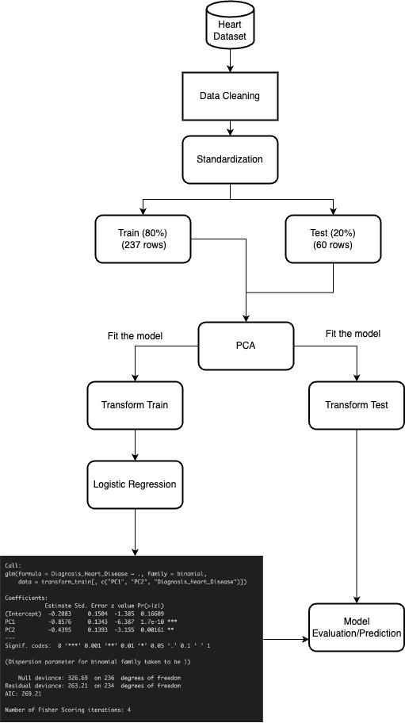
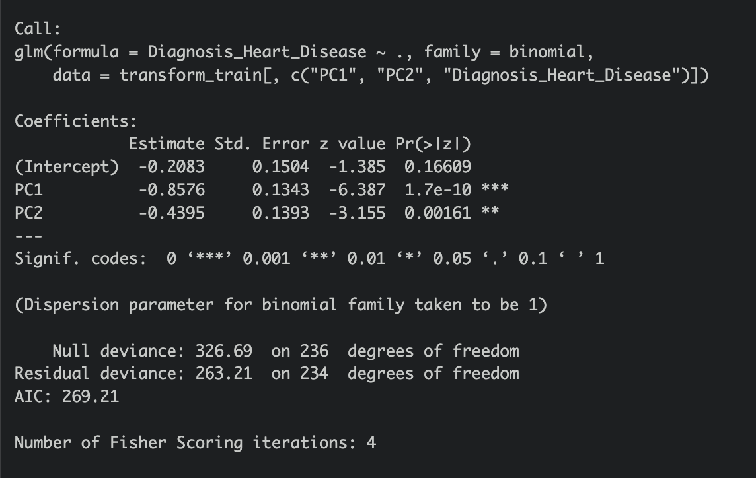
PCA & Logistic Regression
Numerical variables
Data split: 80% training, 20% testing.

Slide 27
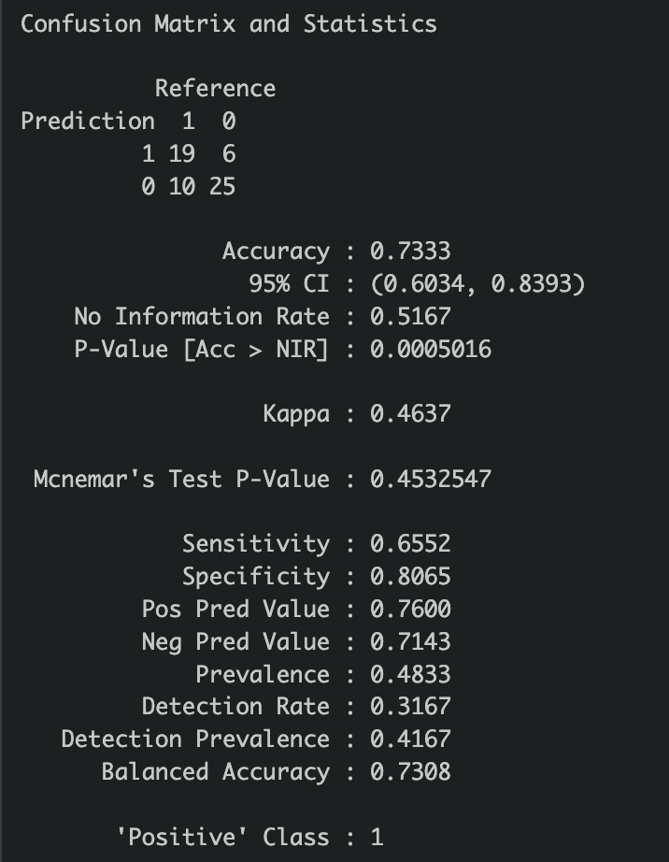
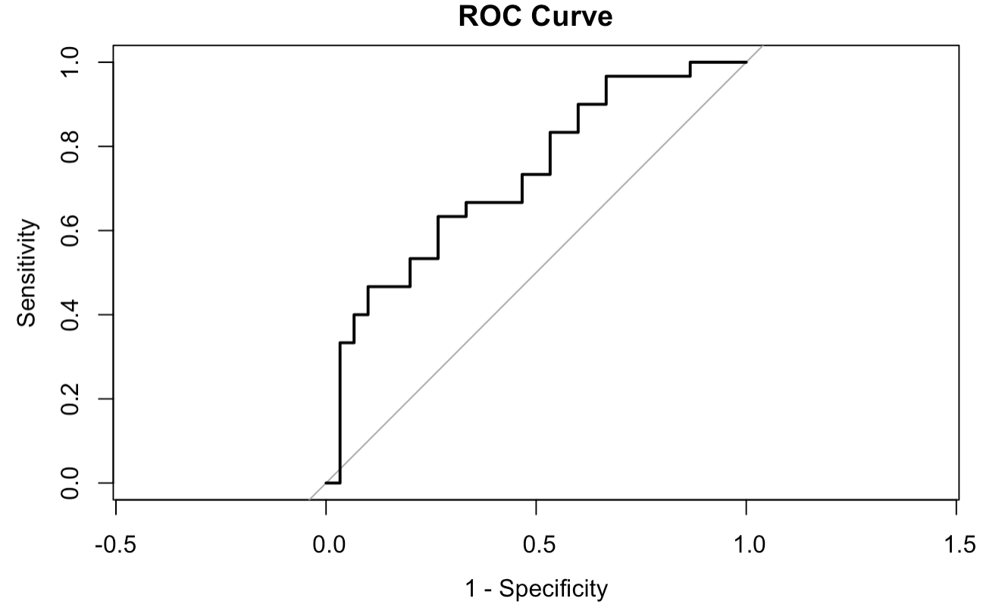
Classification Results
The model achieves balanced performance, with sensitivity (65.52%) and specificity (80.60%) showing fair discrimination between heart disease and no heart disease cases.
Positive Predictive Value (76%) demonstrates reasonable reliability in predictions.

Slide 28
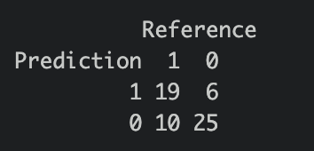
Weakness
Improvements
Misses 6 heart disease cases (False Negatives), which can have real-world implications.
Room for improvement in precision and overall agreement.
The model performs moderately well but could be enhanced through -
better feature engineering, alternative classifiers, or further hyperparameter tuning.
We can have multiple components to retain maximum information of the data.

Slide 29
LDA
Linear Discriminant Analysis (LDA) is a supervised machine learning algorithm used for classification and dimensionality reduction.
It aims to project data onto a lower-dimensional space while maximizing the separation between multiple classes.
Evaluating classification efficacy with Linear Discriminant Analysis (LDA).
Notes:
LDA is called as supervised method because it has information about which group the data point belongs to in order to best separate the groups.
We will check how LDA helps us classify the 2 groups in Heart Diagnosis

Slide 30
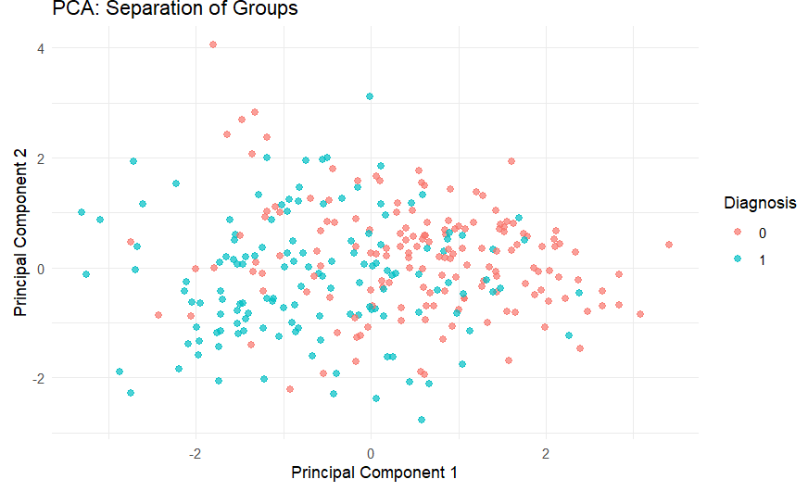
LDA vs PCA
This plot represents the data's distribution in terms of its principal components (PC1 and PC2).
There is moderate separation between the two classes, but considerable overlap is present.

Slide 31
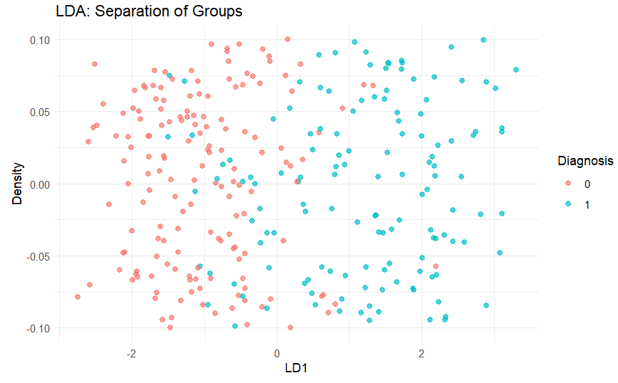
LDA vs PCA
The horizontal axis is LD1, representing the direction that best separates the two classes.
The separation between the two classes is much more distinct and overlap is significantly reduced.

Slide 32
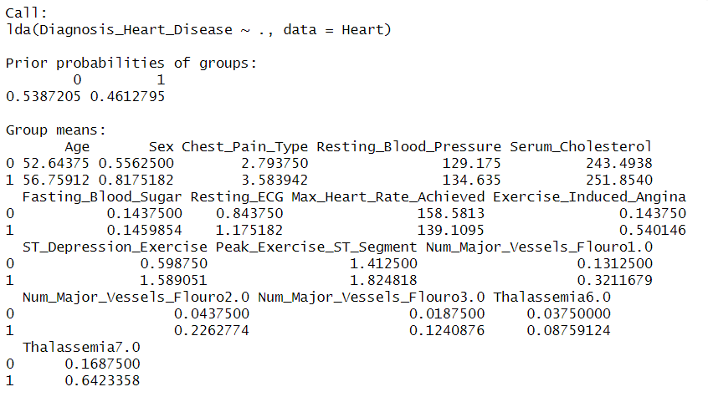
LDA Model Output
Notes:
This indicates that LDA was performed using Diagnosis_Heart_Disease as the target variable and all other variables (.) as predictors.
Individuals with heart disease tend to be older.
Males seem to have a higher likelihood of heart disease.
slightly higher resting blood pressure AND Cholesterol levels are slightly higher in patients with Heart disease

Slide 33
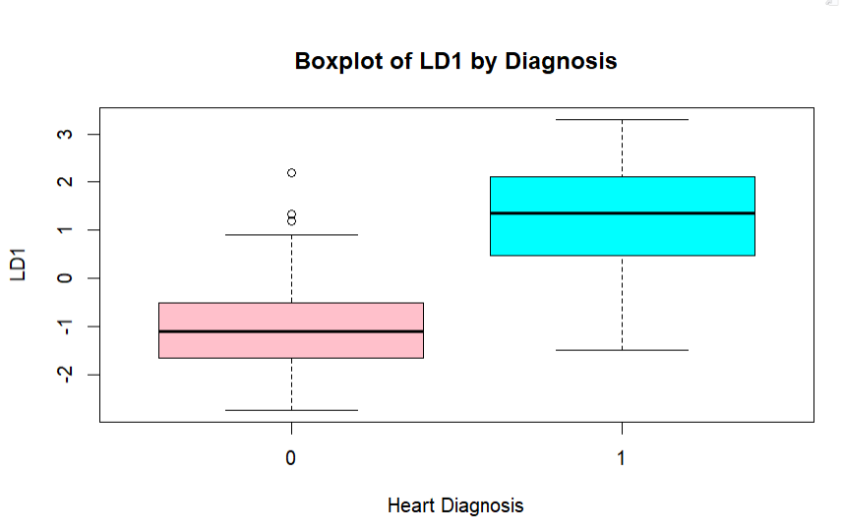
Boxplot
There is clear separation between the LD1 distributions for 0 and 1.
The median LD1 for group 0 is negative, while for group 1 it is positive. This indicates that LD1 effectively separates the two groups.
Notes:
Compare the distributions of each discriminant function across classes.
Boxplot shows that There is clear separation between the LD1 distributions for 0 and 1.
The median LD1 for group 0 is negative, while for group 1 it is positive. This indicates that LD1 effectively separates the two groups.

Slide 34
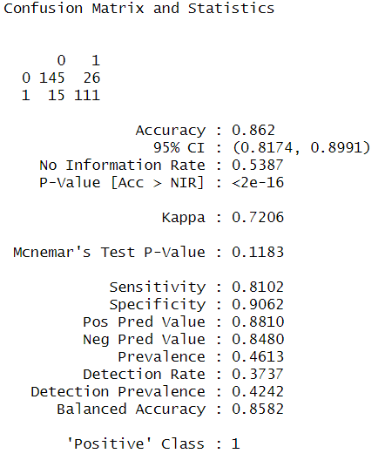
Classification Results
The LDA model shows good overall performance with high accuracy of 86.2% .
It achieves balanced performance, with sensitivity (81%) and specificity (90.60%) showing fair discrimination between heart disease and no heart disease cases.
Positive Predictive Value (88%) demonstrates reasonable reliability in predictions.

Slide 35
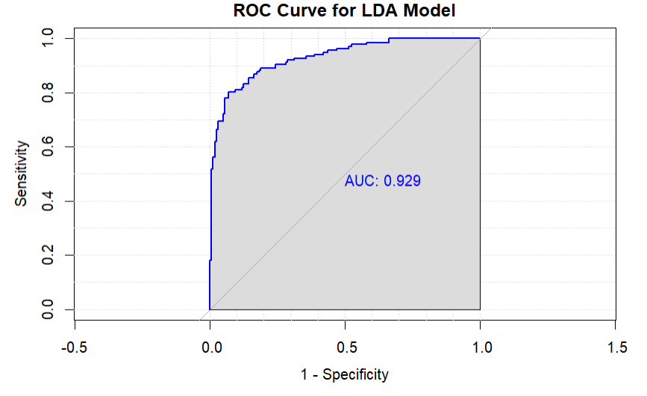
ROC Curve
An AUC of 0.929 indicates that model is performing very well in distinguishing between the two classes of Heart Diagnosis.
Notes:
An AUC of 0.929 means that in 92.9% of randomly chosen pairs of positive and negative samples, the model will correctly rank the positive sample higher than the negative one.
There one more thing we can do to check if model can improve based on the current data distribution. That is setting a threshold value.

Slide 36
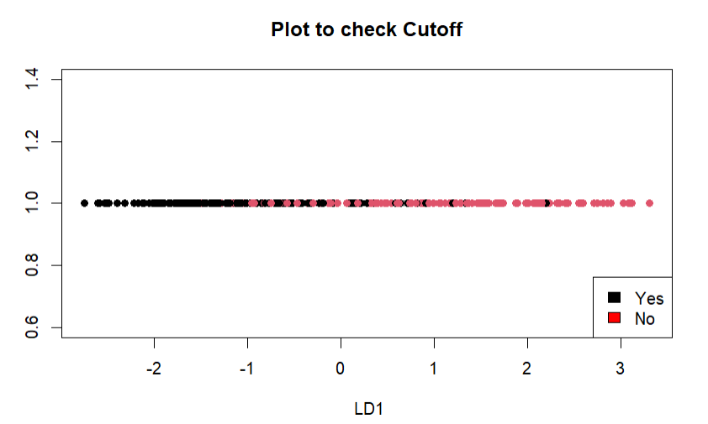
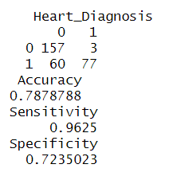
Cut off Value
Cut off 1.2
Notes:
The model correctly classifies 78.79% of the cases overall. While this is fairly good, there is room for improvement
The model correctly identifies 96.25% of patients who actually have heart disease. This is a very high value, indicating that the model is excellent at detecting true positives
The model correctly identifies 72.35% of patients who do not have heart disease. The lower specificity indicates that the model is more likely to classify some healthy individuals as having heart disease

Slide 37
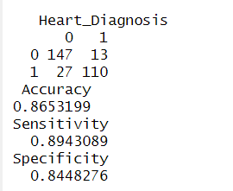
Cut off Value
By adjusting the cutoff to 0.2, we have improved both sensitivity and specificity.
There’s now a better balance between identifying true positives (patients with heart disease) and true negatives (healthy patients).

Slide 38
Weakness
15 false negative cases shows that there is still room for improvement, particularly if the goal is to minimize false negatives or missing heart disease cases.
26 false positives, which means the model is predicting heart disease in some patients who don’t actually have it.
Improvements
To improve model performance we can identify and keep only the most relevant features. Also as our data is not completely balance we can use sampling methods.
Also another way to improve is additional feature selection or transformation to help the model better differentiate between the two classes.
Notes:
Adjusting the Cutoff: The current cutoff might have been chosen to favor sensitivity. Adjusting the cutoff point might provide a better balance between sensitivity and specificity.
Feature Engineering: Additional feature selection or transformation could help the model better differentiate between the two classes.
If class imbalance is an issue, you could try using resampling methods like SMOTE (Synthetic Minority Over-sampling Technique) or undersampling of the majority class.

Slide 39
Stepwise Regression
In this analysis, stepwise regression was performed on the heart disease dataset to identify the most significant predictors of heart disease diagnosis.
Stepwise regression is a systematic method for adding or removing predictors based on their statistical significance in explaining the dependent variable.
It balances model complexity and predictive power by retaining only variables that contribute meaningfully to the model.

Slide 40
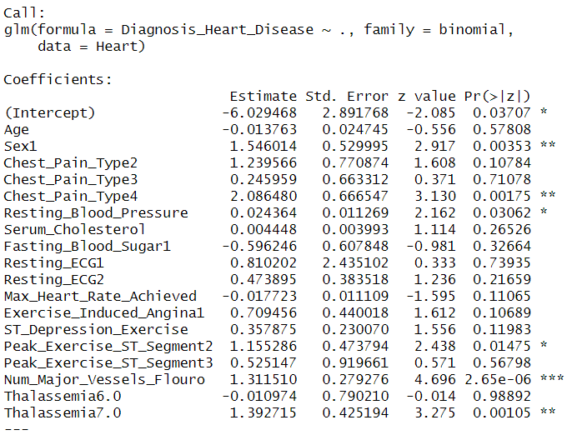
Regression Model with All Variables

Slide 41
Stepwise Regression
Preparation
70 % of data was taken as training set, and 30% test set.
Defined the full model and the null model

Slide 42
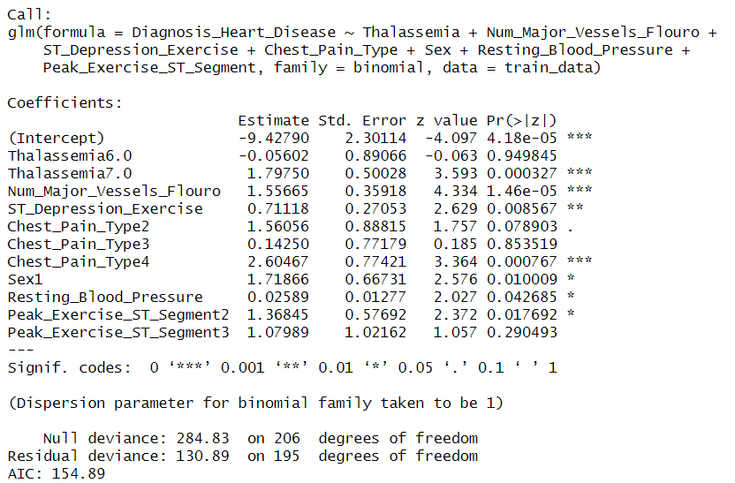
Forward Stepwise Regression

Slide 43
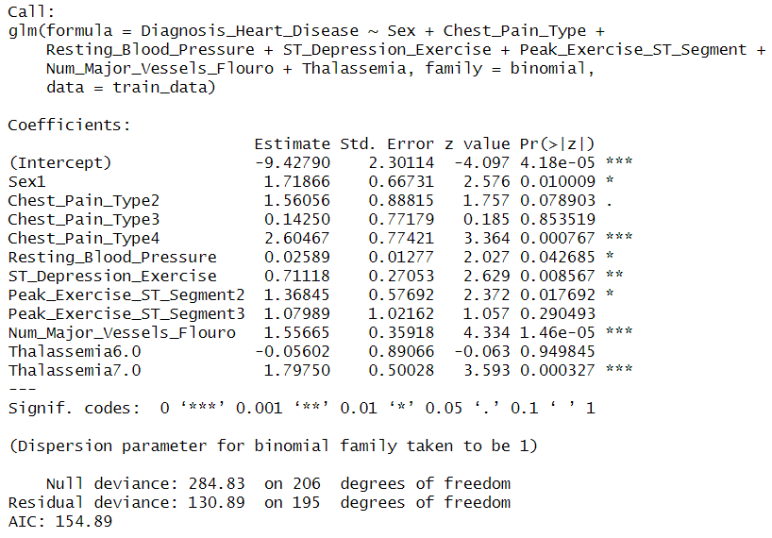
Backward Stepwise Regression

Slide 44
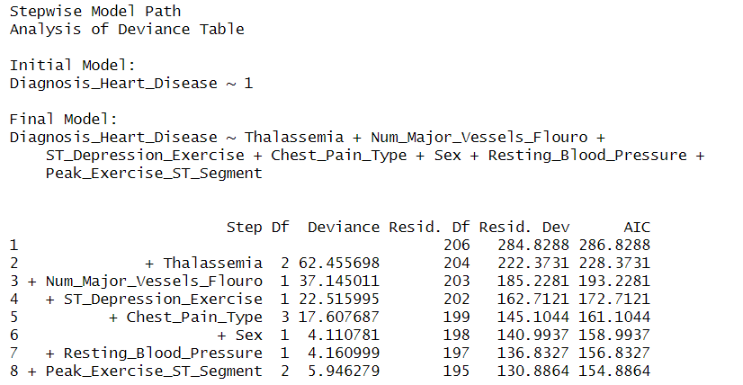
Both Directions Stepwise Regression

Slide 45
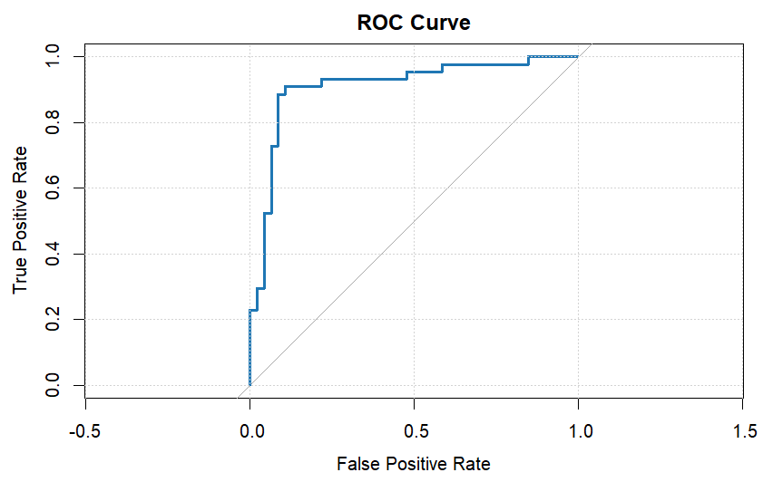
Determining the most accurate threshold for classification
ROC Curve and Youden's J Statistic
The optimal threshold at 0.3539965

Slide 46
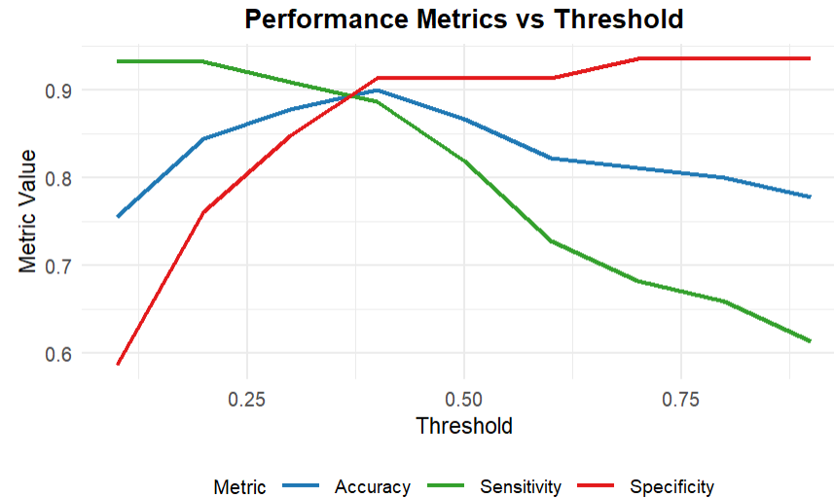
Performance Metrics across Thresholds
Optimal Threshold is 0.4

Slide 47
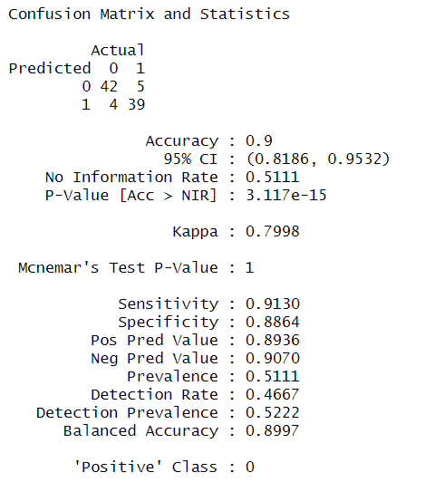
Validate the chosen threshold

Slide 48
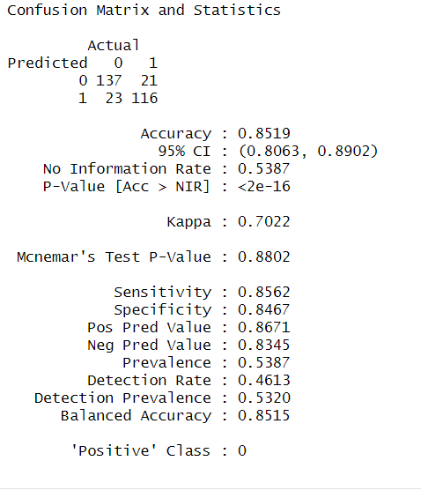
For the Complete Data Set

Slide 49
Factor Analysis
Factor Analysis is a method for modeling observed variables, and their covariance structure, in terms of a smaller number of underlying unobservable (latent) “factors.”
The purpose of factor analysis is to identify the hidden relationships between variables and to reduce the dimensionality of data while retaining as much variance as possible.

Slide 50
Why do we need Factor Analysis for this data?
Key Reasons for Using Factor Analysis
Identify Latent Constructs
Variables like ST_Depression_Exercise, Max_Heart_Rate_Achieved, Serum_Cholesterol, and Resting_Blood_Pressure are interrelated.
Factor Analysis reveals hidden patterns (e.g., Cardiovascular Stress or Vascular Risk) that explain relationships among these variables.
Reduce Dimensionality
Simplifies analysis by reducing five interrelated variables into a smaller set of meaningful factors.
Removes redundancy caused by high correlations (e.g., ST_Depression_Exercise and Max_Heart_Rate_Achieved).

Slide 51
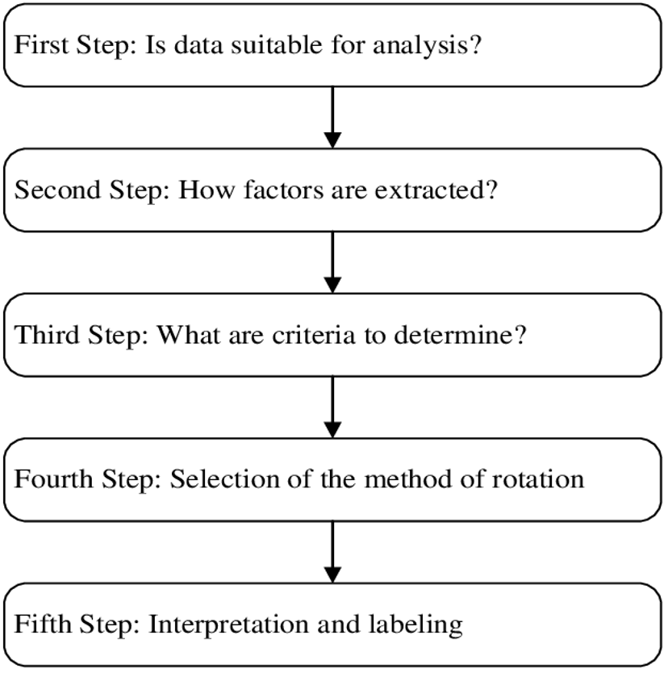
Steps to Conduct EFA

Slide 52
Step 1: Is Data Suitable for FA? – Correlations in Dataset
Bartlett’s Test of Sphericity:
Bartlett’s Test of Sphericity compares an observed correlation matrix to the identity matrix. Essentially, it checks to see if there is a certain redundancy between the variables that we can summarize with a few number of factors.
Hypothesis:
Null Hypothesis: The null hypothesis of the test is that the variables are orthogonal, i.e., not correlated.
Alternate Hypothesis: The variables are correlated.
Results
p-value = 2.008212e-25
Since the p-value < 0.05, we reject the null hypothesis.
Conclusion: Variables are correlated, factor Analysis is suitable.

Slide 53
Step 1: Is Data Suitable for FA? – Power: Test of Sampling Adequacy
Purpose of KMO Test:
Kaiser-Meyer-Olkin (KMO) Measure of Sampling Adequacy:
Compares the observed correlation coefficients to partial correlation coefficients.
Larger KMO values indicate that correlations between variable pairs can be explained by other variables in the dataset.
KMO Value: 0.549746
Interpretation: Since KMO > 0.5, the data is adequate for Factor Analysis.

Slide 54
How many factors/components do I have?
We used two methods to determine the number of factors:
Parallel Analysis
Kaiser Criterion - Note this is sometimes still used but usually not recommended.

Slide 55
Parallel Analysis
Purpose of Parallel Analysis:
Parallel Analysis is a statistical test used to determine how many factors to retain in Factor Analysis.
How it works:
Calculates the eigenvalues for your data.
Randomizes the data and recalculates the eigenvalues.
Compares the real eigenvalues to the randomly generated eigenvalues to assess if the real eigenvalues are significantly larger than those from random data.

Slide 56
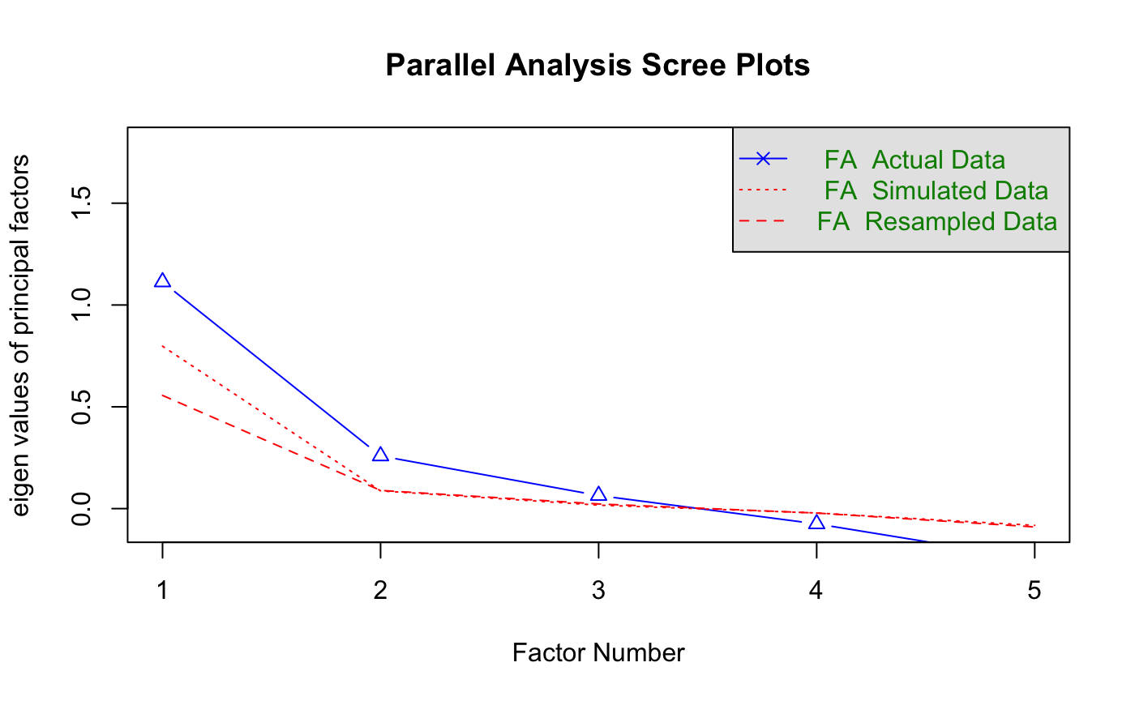
Parallel Analysis Scree Plots
We have used the maximum likelihood method for extraction purposes.
The parallel analysis suggests that we have three significant factors in the dataset.

Slide 57
Kaiser Criterion
1. What is the Kaiser Criterion?
Retains only factors with eigenvalues greater than 0.7.
Assumes that factors with higher eigenvalues are more important as they explain more variance than a single variable.
2. Application to Our Dataset:
Result: Only 1 factor was retained because only one eigenvalue was greater than 0.7.
3. Insight:
The Kaiser Criterion emphasizes simplicity but may underestimate the number of factors in complex datasets.

Slide 58
Resolving Factor Selection: Kaiser Criterion vs. Parallel Analysis
1. Issue Identified
Kaiser Criterion suggests 1 factor.
Parallel analysis suggests 3 factors.
2. Why the Difference?
Kaiser Criterion: Retains factors with eigenvalues > 0.7 but does not account for random noise, often underestimating factors.
Parallel Analysis: Compares eigenvalues to randomized data and identifies statistically significant factors, often more reliable.
3. Decision:
Parallel analysis is preferred as it is more robust and accounts for noise.
Retaining 3 factors ensures meaningful variance is captured in the data.

Slide 59
Factor Rotation
1. Purpose of Factor Rotation
Minimizes complexity of factor loadings, making the structure easier to interpret.
Factor loadings matrices are not unique—there are many possible orientations of factors that explain the data equally well.
Rotation attempts to find the best simple structure.
2. Types of Factor Rotation
Orthogonal Rotation
Factors are uncorrelated.
Example: Varimax.
Advantage: Easier to interpret with uncorrelated factors.
Limitation: Often unrealistic in real-world data, reducing the likelihood of a simple structure.
Oblique Rotation
Factors can be correlated.
Example: Promax.
Advantage: Produces simpler structures, often leading to more interpretable solutions.
Limitation: Allows for correlated factors, which might complicate interpretation in some contexts.

Slide 60
Factor Rotation - No Rotation
Key Observations:
ML1: Dominated by Age (positive) and Max Heart Rate Achieved (negative). It could represent a latent factor related to age-related cardiovascular fitness or performance.
ML2: Influenced by Age, Max Heart Rate Achieved, and Resting Blood Pressure, suggesting it might capture a general health or cardiovascular stress factor.
ML3: Affected primarily by ST_Depression_Exercise and Resting Blood Pressure, indicating it might reflect exercise-induced stress response.
Variable | ML1 | ML2 | ML3
ST_Depression_Exercise | 0.407 | -0.169 | 0.426
Age | 0.744 | 0.406 | -
Max_Heart_Rate_Achieved | -0.748 | 0.41 | -
Serum_Cholesterol | 0.142 | 0.251 | -
Resting_Blood_Pressure | 0.26 | 0.307 | 0.323

Slide 61
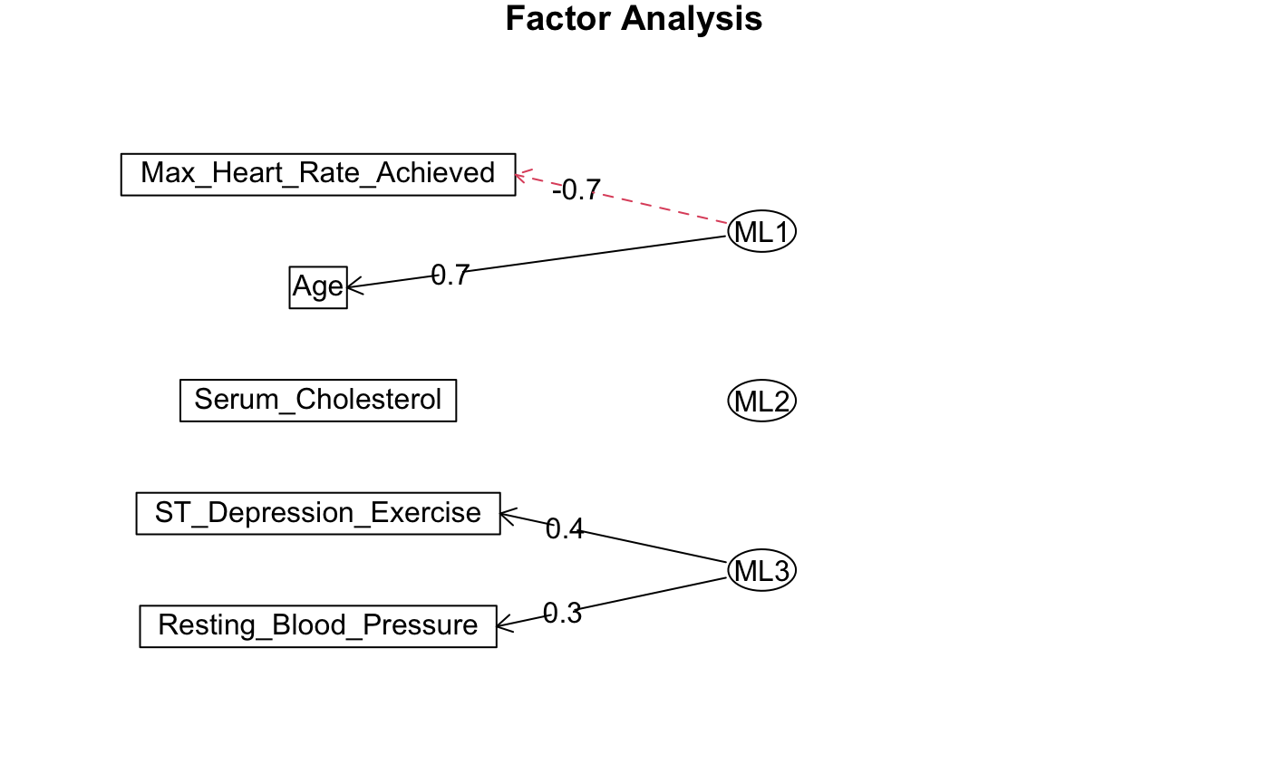
Diagram/ Variance Explained - No Rotation
Factor | SS Loadings | Proportion of Variance | Cumulative Variance
ML1 | 1.365 | 27.30% | 27.30%
ML2 | 0.519 | 10.40% | 37.70%
ML3 | 0.299 | 6.00% | 43.70%

Slide 62
Factor Rotation- Varimax
Latent Variables (Factors)
ML1 (Cardiovascular Activity):Primarily associated with Max_Heart_Rate_Achieved (0.814). This suggests ML1 might represent a factor related to exercise capacity or cardiac performance.
ML2 (Age-Related cardiovascular health):Strong correlation with Age (0.710) and moderate association with Resting_Blood_Pressure (0.422).
ML3 (Exercise-Induced Stress Response):Heavily influenced by ST_Depression_Exercise (0.552) and Max_Heart_Rate_Achieved (-0.262).
Variable | ML1 | ML2 | ML3
ST_Depression_Exercise | -0.249 |  | 0.552
Age | -0.469 | 0.71
Max_Heart_Rate_Achieved | 0.814 |  | -0.262
Serum_Cholesterol |  | 0.292
Resting_Blood_Pressure |  | 0.422 | 0.294

Slide 63
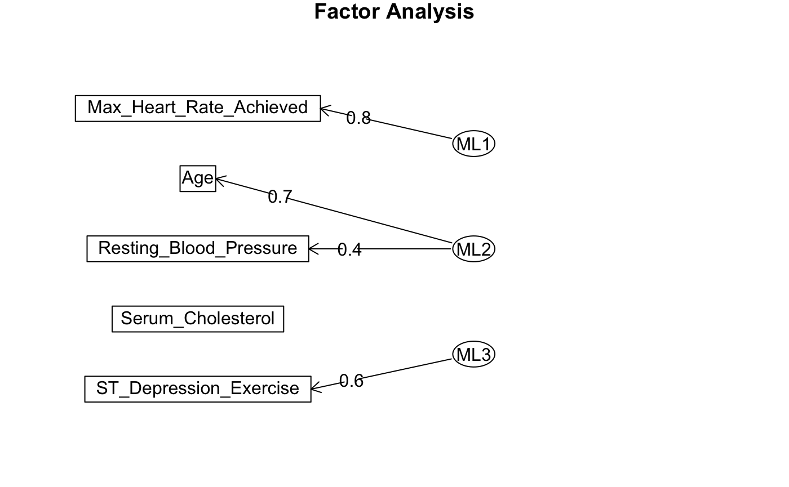
Diagram/Variance Explained : Varimax
Metric | ML1 | ML2 | ML3
SS Loadings | 0.946 | 0.776 | 0.461
Proportion Variance | 0.189 | 0.155 | 0.092
Cumulative Variance | 0.189 | 0.344 | 0.437

Slide 64
Factor Rotation : Oblique
ML1 (Age-Related Cardiovascular Health): This factor is strongly associated with Age (0.83) and moderately with Resting_Blood_Pressure (0.33). It likely reflects the relationship between aging and cardiovascular indicators such as blood pressure.
ML2 (Cardiac Performance): Primarily linked to Max_Heart_Rate_Achieved (0.81), this factor suggests a focus on the heart's response to physical exertion, representing cardiac efficiency or exercise capacity.
ML3 (Stress-Induced Cardiac Effects): Dominated by ST_Depression_Exercise (0.51) and moderately influenced by Resting_Blood_Pressure (0.37). This factor indicates the impact of stress (exercise-induced depression in the ST segment) on cardiac function.
Variable | ML2 | ML1 | ML3 | h² | u² | Complexity (com)
ST_Depression_Exercise | -0.06 | -0.26 | 0.51 | 0.3751 | 0.6249 | 1.51
Age | 0.83 | -0.07 | -0.02 | 0.7253 | 0.2747 | 1.01
Max_Heart_Rate_Achieved | -0.07 | 0.81 | -0.03 | 0.7306 | 0.2694 | 1.02
Serum_Cholesterol | 0.29 | 0.17 | 0.07 | 0.0859 | 0.9141 | 1.71
Resting_Blood_Pressure | 0.33 | 0.23 | 0.37 | 0.2662 | 0.7338 | 2.68

Slide 65
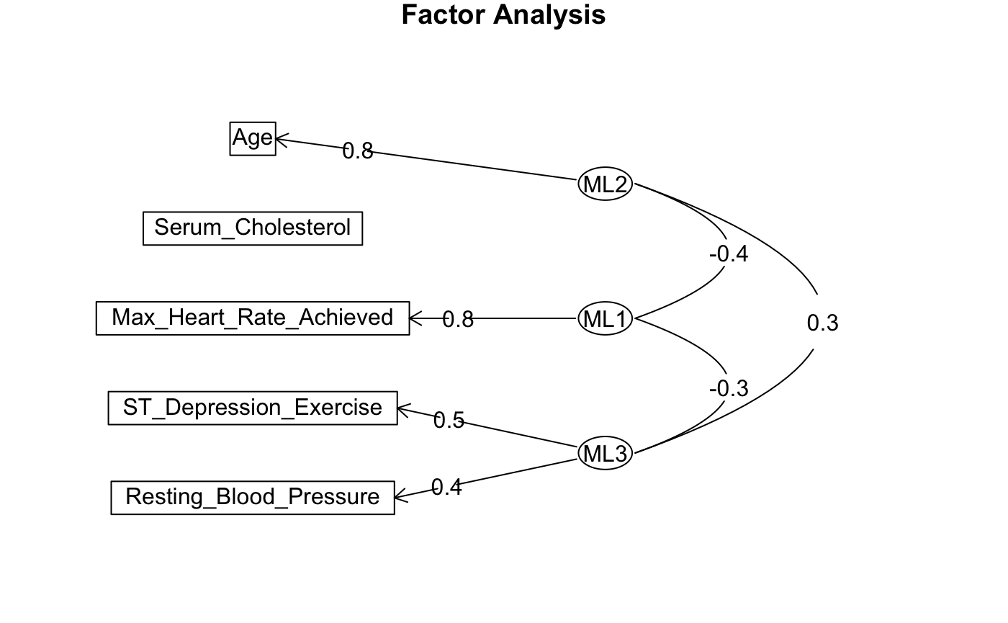
Oblique Diagram

Slide 66
MCA
The Multiple correspondence analysis (MCA) is an extension of the simple correspondence analysis for summarizing and visualizing a data table containing more than two categorical variables.
It can also be seen as a generalization of principal component analysis when the variables to be analyzed are categorical instead of quantitative.

Slide 67
Variables for MCA
Categorical Variables in the Dataset:
Sex: Male/Female
Exercise_Induced_Angina: Yes/No
Chest_Pain_Type: TYPICAL ANGINA, ATYPICAL ANGINA, NON-ANGINAL PAIN, ASYMPTOMATIC
Resting_ECG: NORMAL, ABNORMALITY, PROBABLE OR DEFINITE
Num_Major_Vessels_Flouro: Categories of vessels
Thalassemia: Levels of thalassemia
Age_Group: Categories based on age (e.g., <30, 30-45, 46-60, >60)

Slide 68
Chi-Square Test Results and MCA Validation
Variable | Chi-Square Statistic | p-value | Degrees of Freedom | Conclusion
Sex | 21.852 | 2.95E-06 | 1 | Reject H0​: Significant association.
Exercise-Induced Angina | 50.943 | 9.51E-13 | 1 | Reject H0: Significant association.
Chest Pain Type | 77.276 | < 2.2e-16 | 3 | Reject H0 Significant association.
Resting ECG | 9.5755 | 0.008331 | 2 | Reject H0: Significant association.
Num_Major_Vessels_Flouro | 72.301 | 1.37E-15 | 3 | Reject H0: Significant association.
Thalassemia | 82.46 | < 2.2e-16 | 2 | Reject H0:: Significant association.
Age Group | 14.438 | 0.002366 | 3 | Reject H0: Significant association.

Slide 69
MCA Contribution of Variables to Dimensions
Category | Dim 1 | Dim 2 | Dim 3 | Dim 4 | Dim 5
Diagnosis_Heart_Disease_NO | -0.7731 | -0.0088 | 0.081 | -0.0496 | 0.0337
Diagnosis_Heart_Disease_YES | 0.9029 | 0.0103 | -0.0945 | 0.058 | -0.0393
FEMALE | -0.5658 | 0.7807 | 0.361 | -0.2342 | -0.6099
MALE | 0.2702 | -0.3729 | -0.1724 | 0.1119 | 0.2913
Exercise_Induced_Angina_NO | -0.4367 | -0.0249 | 0.1164 | -0.0008 | 0.1625
Exercise_Induced_Angina_YES | 0.9003 | 0.0513 | -0.24 | 0.0017 | -0.335
ASYMPTOMATIC | 0.7092 | 0.085 | -0.0839 | 0.1243 | -0.386
ATYPICAL ANGINA | -0.888 | -0.2603 | -0.2335 | 1.0813 | -0.1189
NON-ANGINAL PAIN | -0.6348 | 0.3092 | -0.2474 | -0.8304 | 0.5196
TYPICAL ANGINA | -0.1958 | -1.0862 | 1.9086 | -0.0744 | 0.7612
ABNORMALITY | 0.5821 | 4.8161 | -0.3539 | 1.9242 | 0.0699

Slide 70
MCA Contribution of Variables to Dimensions
Category | Dim 1 | Dim 2 | Dim 3 | Dim 4 | Dim 5
NORMAL | -0.2505 | -0.226 | -0.4358 | -0.1892 | -0.3399
PROBABLE OR DEFINITE | 0.2362 | 0.0956 | 0.4485 | 0.1378 | 0.3403
Num_Major_Vessels_Flouro_0.0 | -0.5021 | -0.2042 | -0.0928 | 0.1099 | -0.1026
Num_Major_Vessels_Flouro_1.0 | 0.5577 | 0.2965 | -0.1624 | -0.7199 | 0.7106
Num_Major_Vessels_Flouro_2.0 | 0.8748 | -0.1441 | 1.1381 | 0.2309 | -1.3877
Num_Major_Vessels_Flouro_3.0 | 0.8934 | 1.0863 | -0.8275 | 0.945 | 1.2199
Thalassemia_3.0 | -0.6401 | 0.2251 | 0.1446 | 0.0017 | -0.0873
Thalassemia_6.0 | 0.7594 | -0.197 | 0.9598 | 1.301 | 0.5251
Thalassemia_7.0 | 0.794 | -0.2902 | -0.3565 | -0.206 | 0.0423
30-49 | -0.6228 | -0.5714 | -0.696 | 0.3242 | -0.29
50-69 | 0.2763 | 0.1006 | 0.328 | -0.246 | 0.0862
70 and above | -0.2015 | 2.9249 | -0.9321 | 1.4281 | 0.2632
Under 30 | -1.4885 | -1.565 | 1.5321 | 8.1727 | 4.3162

Slide 71
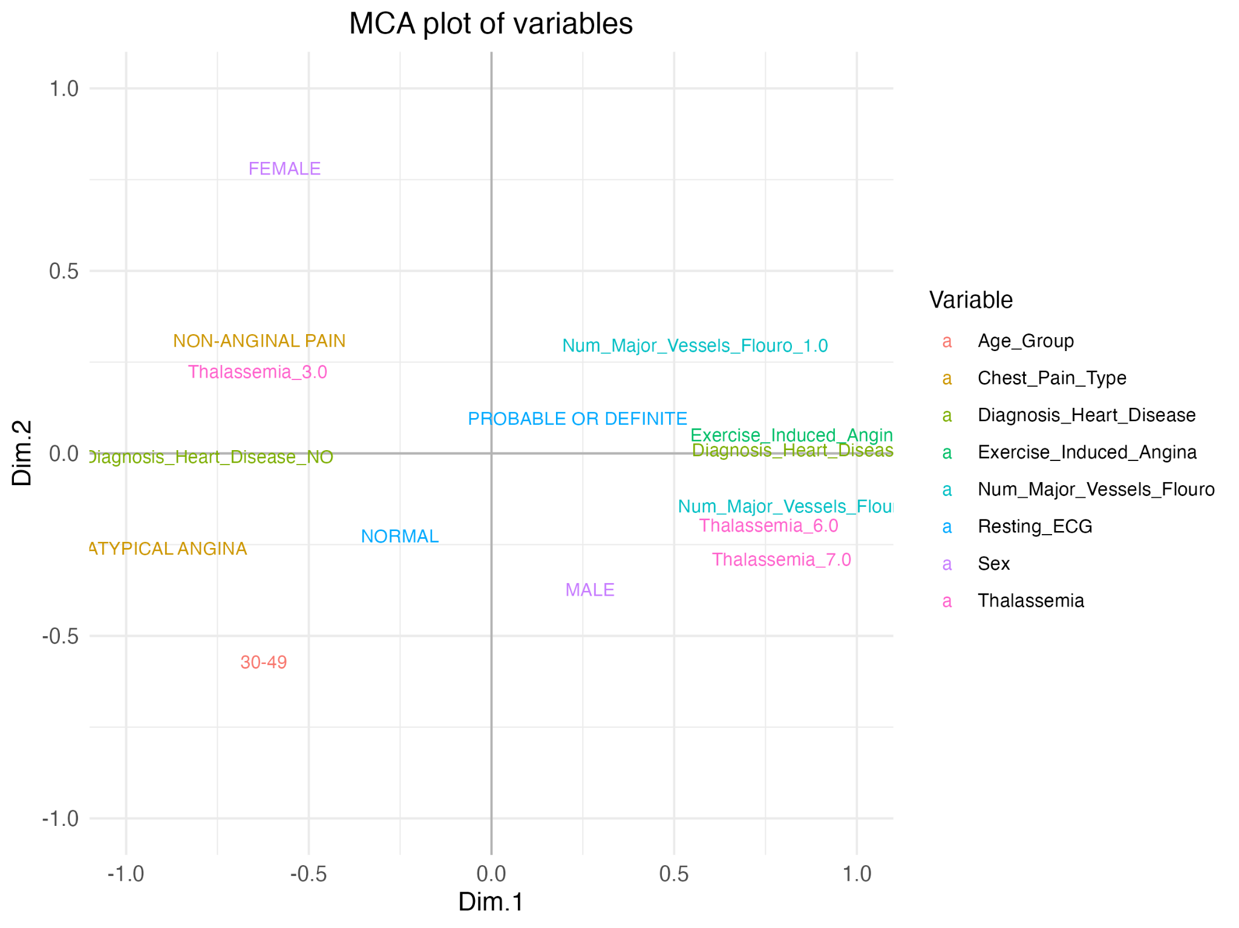
MCA Plot

Slide 72
Interpretations from plot
Dimension 1 (Dim 1) - Key Contributors
Diagnosis_Heart_Disease_YES: 0.9029 (Strong positive)
Diagnosis_Heart_Disease_NO: -0.7731 (Strong negative)
Exercise_Induced_Angina_YES: 0.9003 (Strong positive)
Exercise_Induced_Angina_NO: -0.4367 (Negative)
ASYMPTOMATIC: 0.7092 (Positive)
ATYPICAL ANGINA: -0.8880 (Negative)
NON-ANGINAL PAIN: -0.6348 (Negative)
Interpretation of Dim 1:
Dimension 1 seems to separate individuals based on cardiovascular health, particularly heart disease and related conditions (e.g., angina, thalassemia).
The positive end of Dimension 1 reflects individuals with heart disease, exercise-induced angina, older age groups, and males.
The negative end shows individuals without heart disease, those without exercise-induced angina, younger individuals, and those experiencing non-anginal chest pain.

Slide 73
Interpretations from plot
Dimension 2 (Dim 2) - Key Contributors
FEMALE: 0.7807 (Strong positive)
MALE: -0.3729 (Negative)
ABNORMALITY (ECG): 4.8161 (Very strong positive)
NORMAL (ECG): -0.2260 (Mild negative)
70 and above: 2.9249 (Strong positive)
30-49: -0.5714 (Weak negative)
Interpretation of Dim 2:
Dimension 2 captures the gender, age, and ECG findings.
Females and individuals aged 70 and above cluster positively, indicating different diagnostic patterns or severity.
Abnormal ECG findings are associated with a positive position on the axis.

Slide 74
Summary
Method | Sensitivity | Specificity | Accuracy
PCA | 65.52% | 80.65% | 73%
LDA | 81.02% | 90.62% | 86.2%
Stepwise Regression | 85.62% | 84.67% | 85.19%

Slide 75
Limitations
Dataset limited to 303 samples; results may not generalize to larger populations.
The class imbalance could cause a bias in the modeling.
All methods assume linearity; nonlinear methods were not explored.
The dataset primarily focuses on clinical variables, excluding other important predictors like lifestyle factors (e.g., smoking, diet) or genetic predispositions.

Slide 76
Conclusion of our Study
Based on our analysis on the Cleaveland Dataset we conclude that -
PCA reduced the dataset to 5 components that explains 90% of the variance.
The LDA model is effective enough to classify patients into heart and non heart diseases. Even with false positive due to data imbalance, 90% of the patients’ condition is classified effectively.
The Stepwise Regression revealed the 7 most significant predictors - Thalassemia, Number of Major Vessels (Fluoroscopy),ST Depression Induced by Exercise,Chest Pain Type,Sex,Resting Blood Pressure,Peak Exercise ST Segment
FA revealed 3 underlying factors -Cardiovascular Activity and Exercise Capacity, Age-Related Cardiovascular Health& Exercise Stress and Heart Function During Exercise
MCA identified meaningful patterns among categorical data, complementing quantitative analysis.

Slide 77
Further works
Test on larger, more diverse datasets.
Explore advanced techniques like Random Forest, neural networks with dimensionality reduction to get an efficient predictive model.
Better Handling of Categorical Data

Slide 78
Team Work
Our contribution
Name | Contribution
Shwetha | 25%
Rachel | 25%
Teshani | 25%
Komalpreet | 25%

